Slide 1
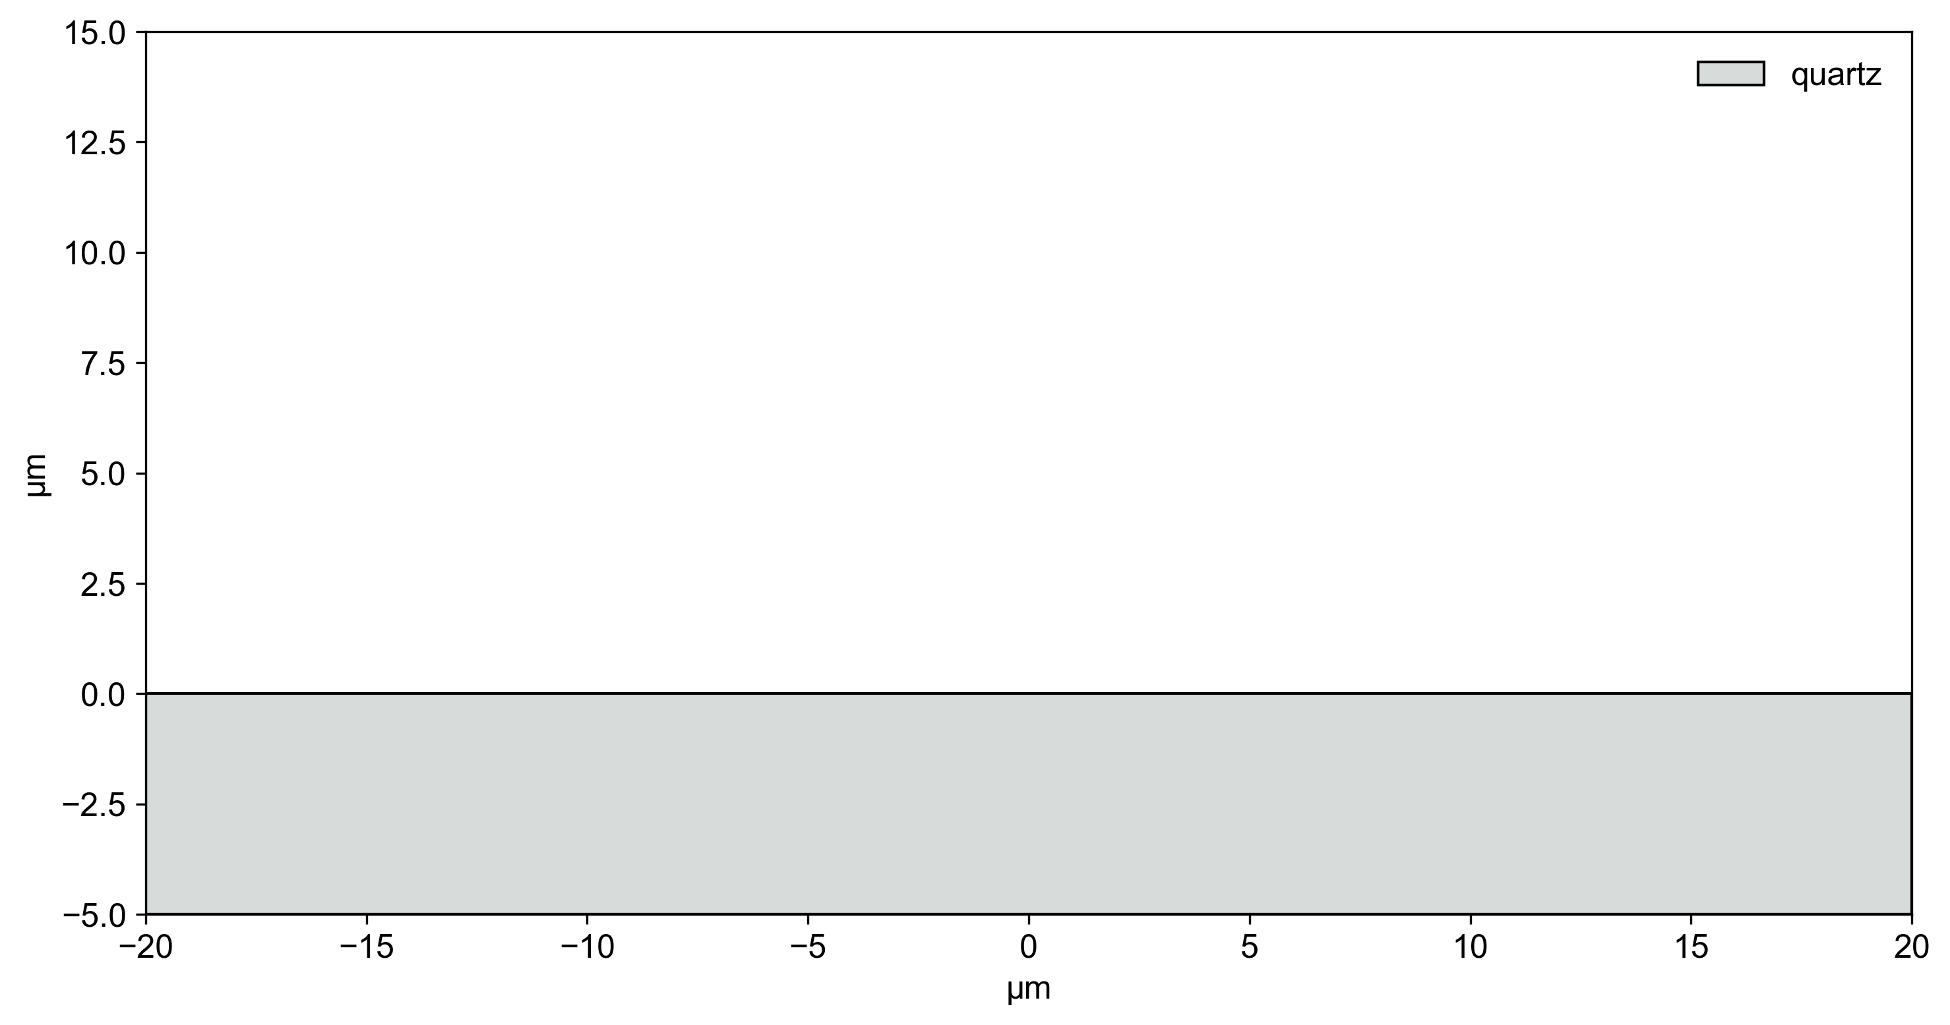
stackmap example
quartz

Slide 2
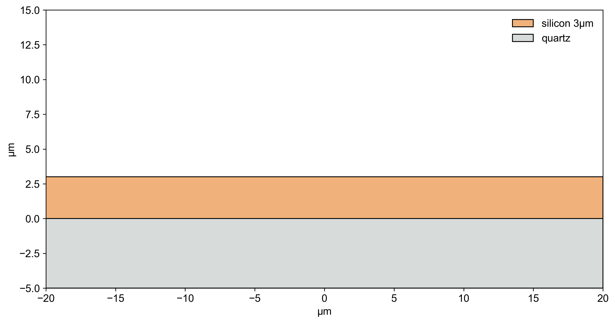
stackmap example
silicon 3µm

Slide 3
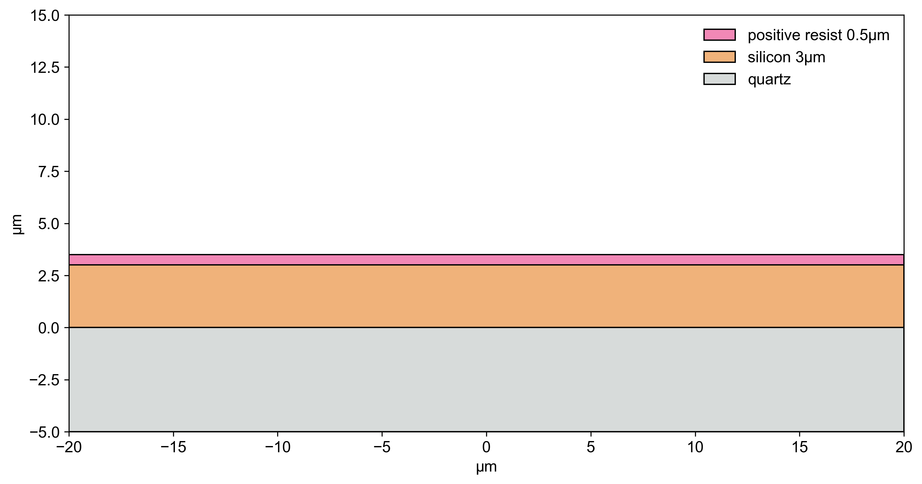
stackmap example
Deposit positive resist 0.5µm

Slide 4
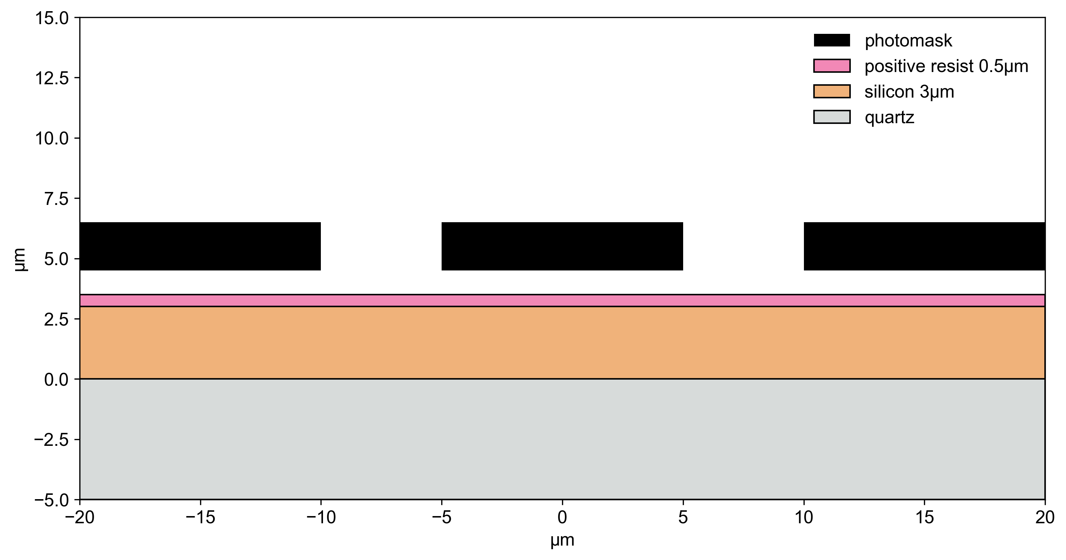
stackmap example
Expose

Slide 5
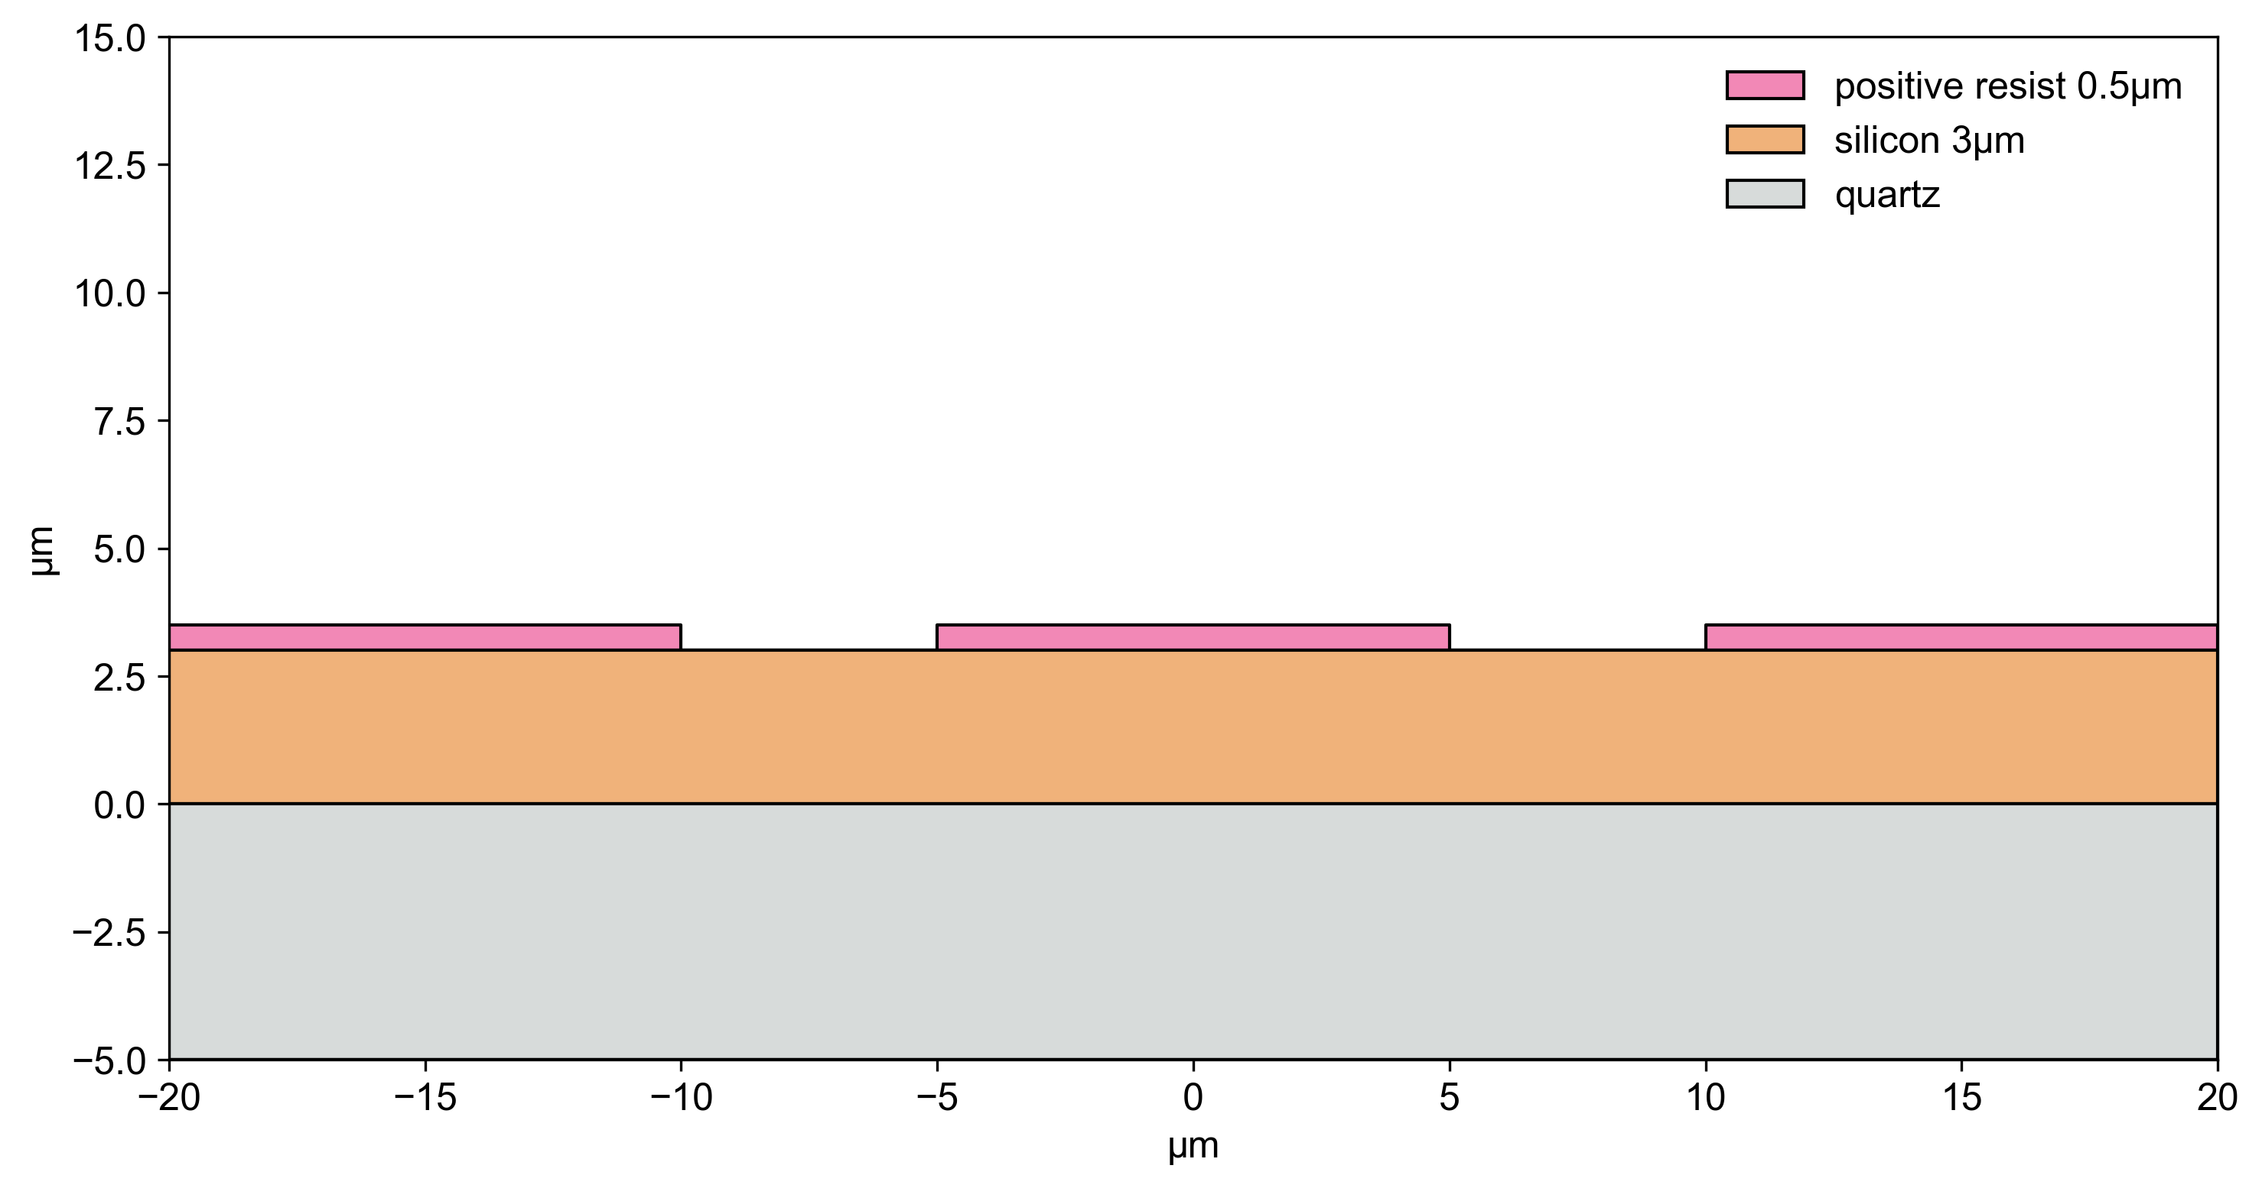
stackmap example
Develop

Slide 6
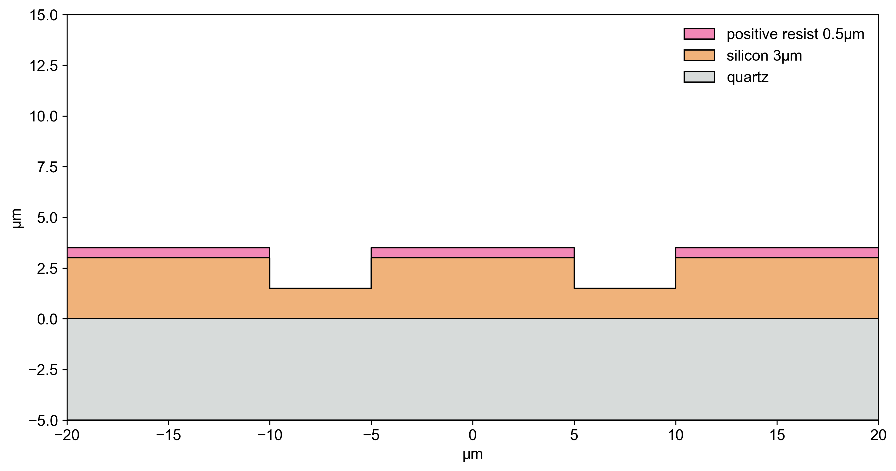
stackmap example
Etch

Slide 7
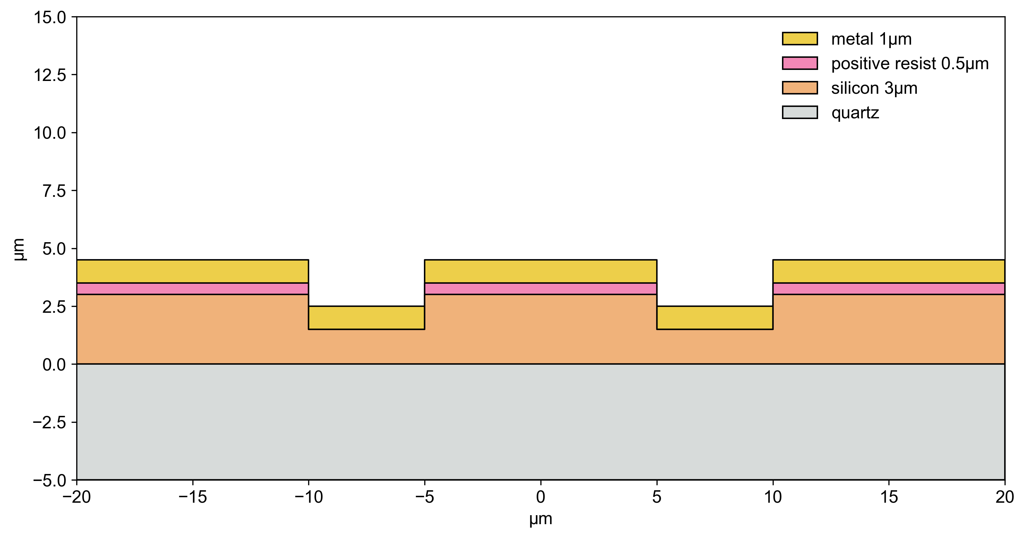
stackmap example
metal 1µm

Slide 8
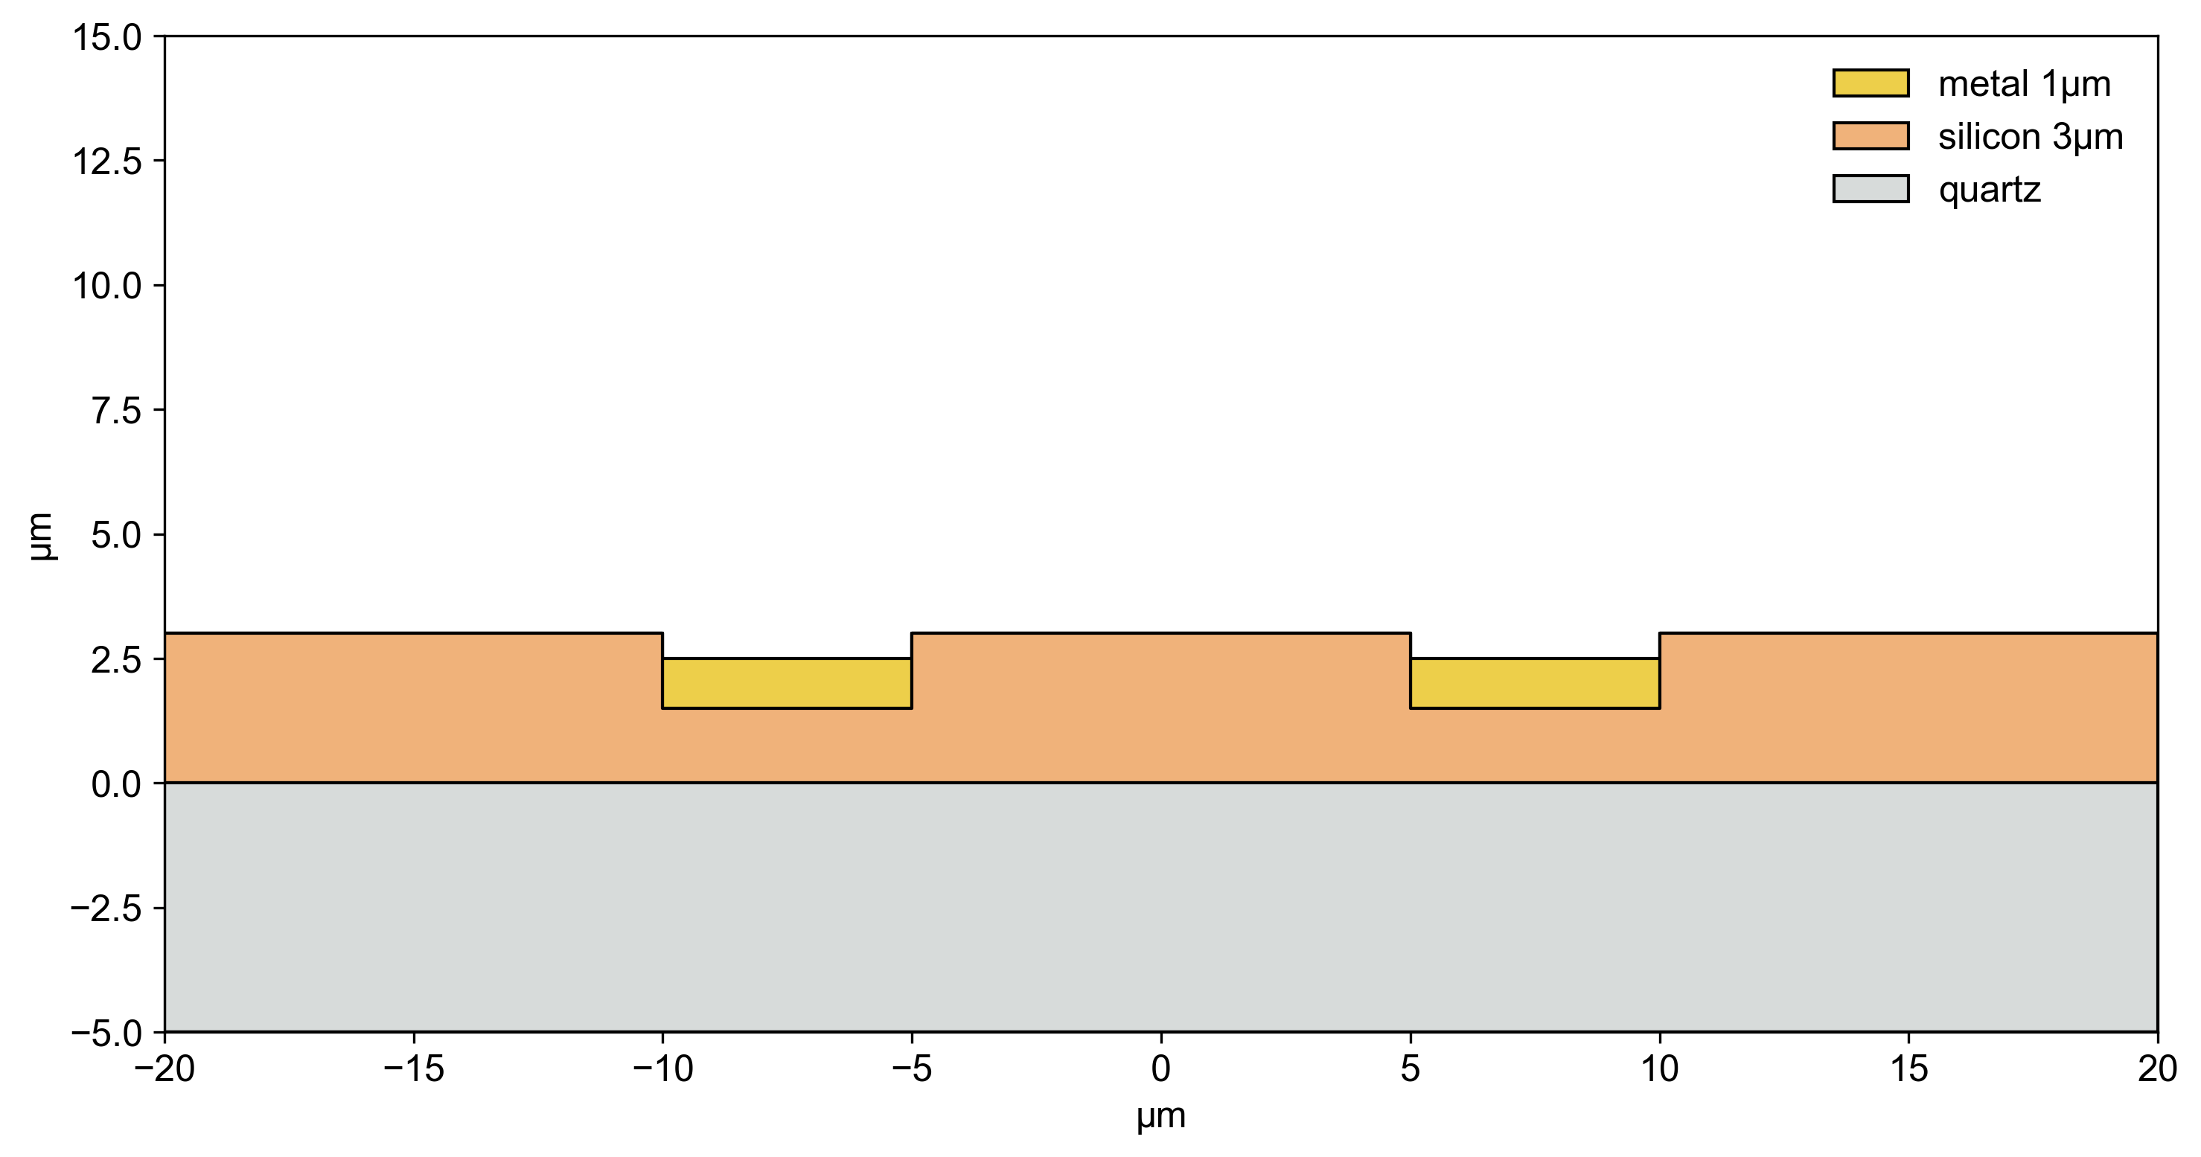
stackmap example
Liftoff

Slide 9
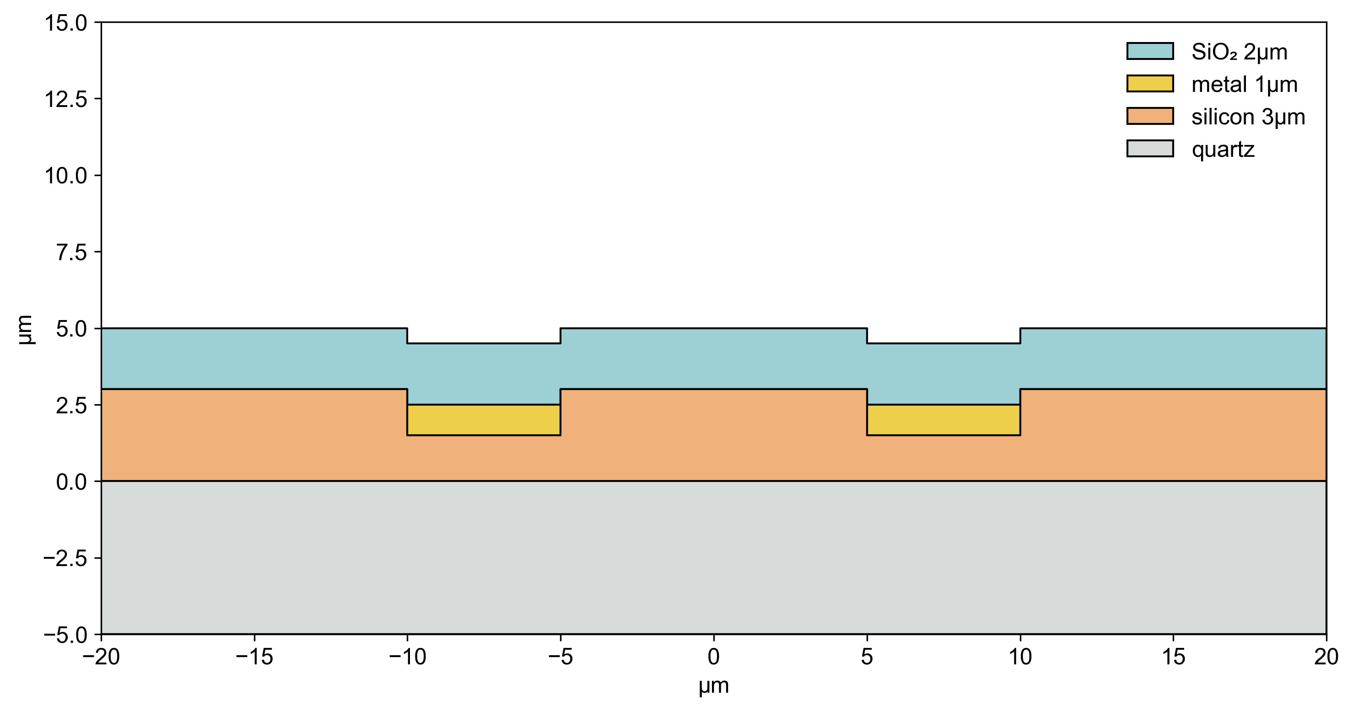
stackmap example
SiO₂ 2µm

